Slide 1
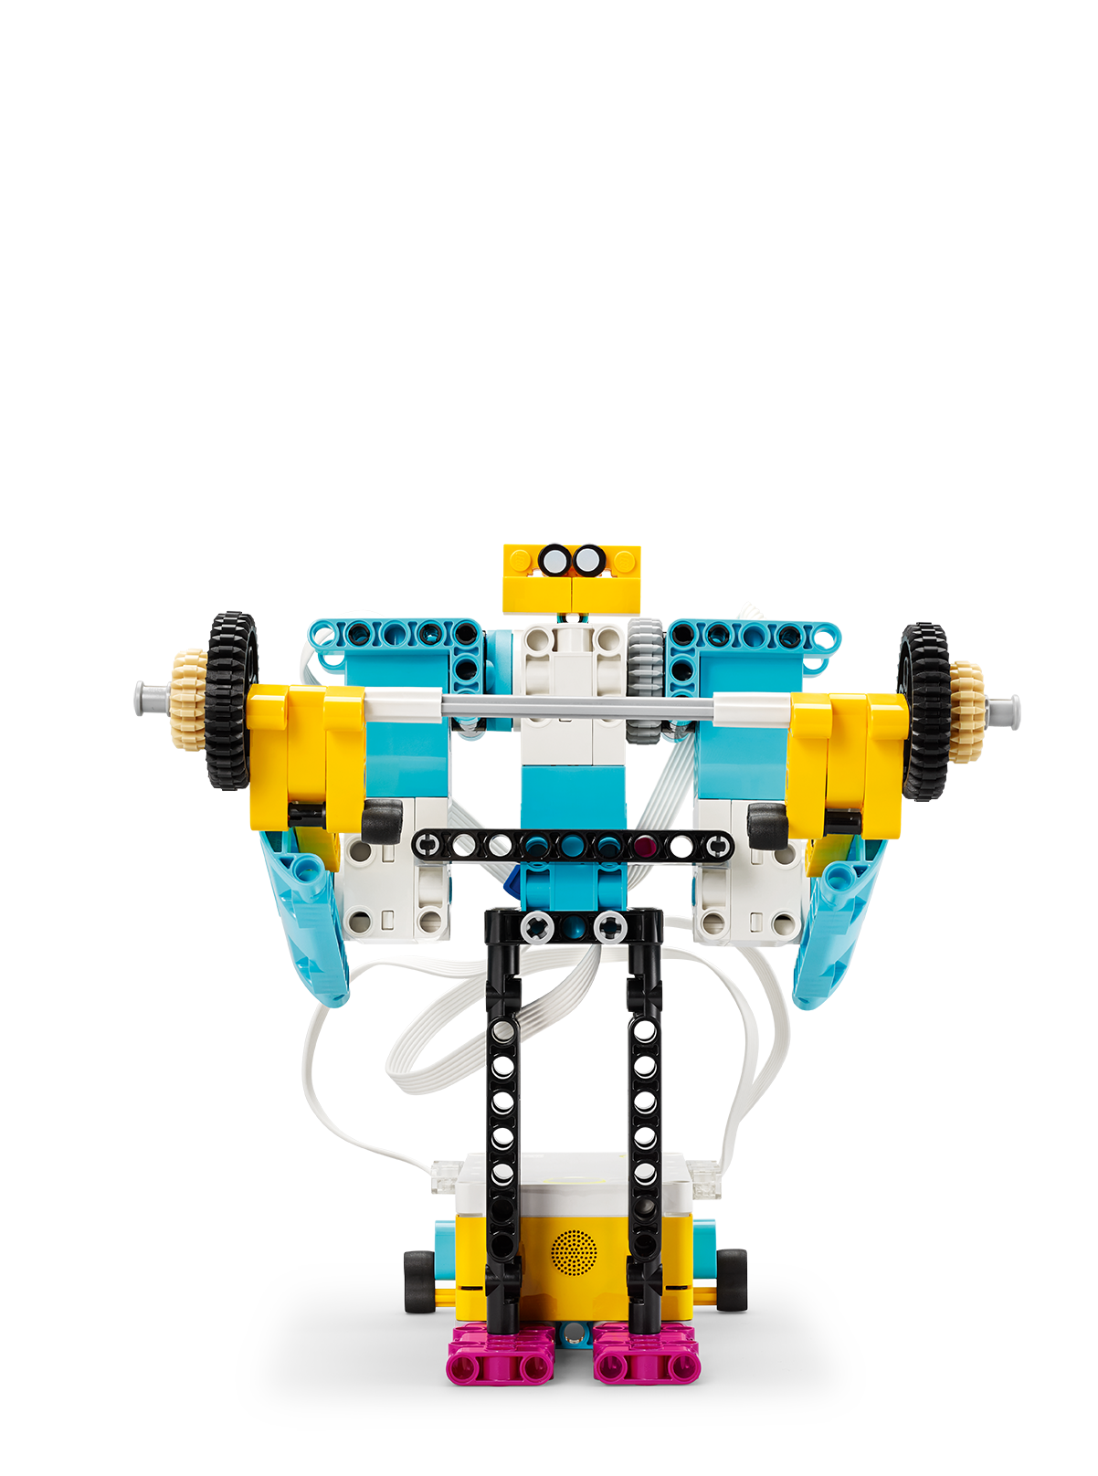
Warm-Up
Practice graphing virtual energy values.
Inventor Notebook
Date: XX, Version: XX, Document Owner: XX, Total page number: XX

Slide 2
Engage
Have a look at the lesson:
https://education.lego.com/en-us/lessons/prime-training-trackers/warm-up/student-worksheet
Take notes of anything you’d like to remember.

Slide 3
Engage
Take a moment to answer these questions.
- Can you name two smart tracking devices and describe what they can track?
- Which type of energy are you expending when you exercise?
- How can you measure that energy?
- Which unit would you use to measure that energy?

Slide 4
Explain
Add a picture or video of your experiment.

Slide 5
Explain
Add a graph to document your results.

Slide 6
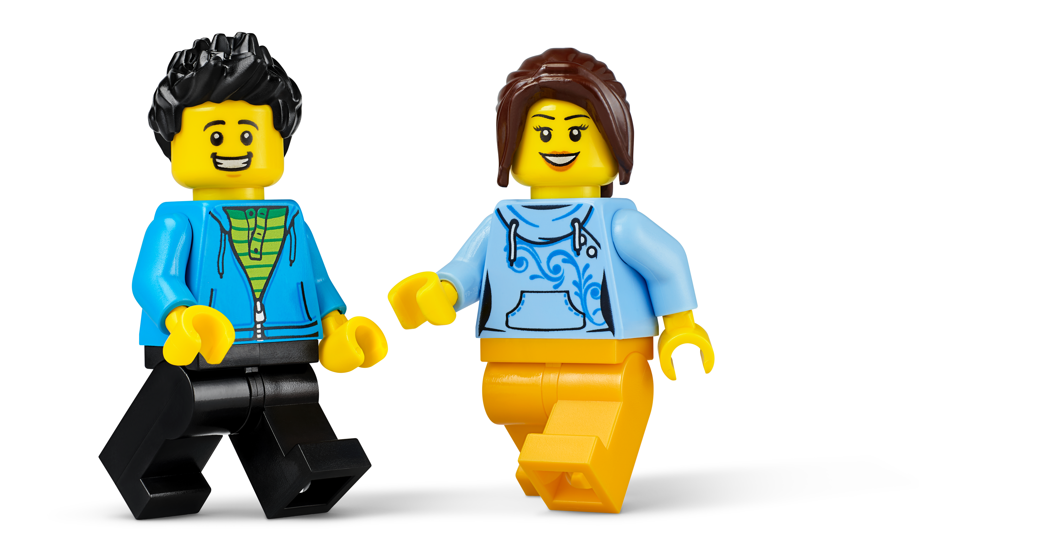
Evaluate
How would you summarize your experiment?

